Slide 1
Functions
Using arguments and sub procedures:
You can pass information to a procedure by enclosing the arguments in parentheses
Call mysub(aninteger, astring) ‘ 2 arguments, an integer ‘ and a string
Sub mysub(ByVal aninteger as integer, ByVal astring as string)
Text1.text = aninteger & “ “ & astring
End Sub

Slide 2

Functions
You can pass variables, constants, values or expressions
Call Myproc(2*5, 300)

Slide 3
Functions
Example:
Private Sub mysub(ByVal aninteger As _ Integer, ByVal astring As String)
Text1.Text = astring & " has an average of " & aninteger
End Sub

Slide 4
Functions
Example:
Private Sub Command1_Click()
Call mysub(75, "John Doe")
End Sub

Slide 5
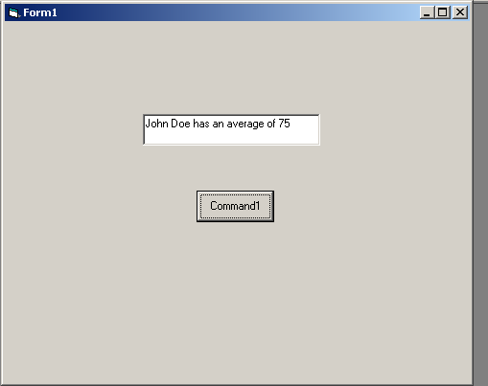
Functions

Slide 6
Functions
ByVal --- passes a copy of the information to the procedure.
The data passed can be modified but it is not reflected in the called procedure

Slide 7
Functions
ByRef --- the parameter is passed by reference. Refer to an arguments memory location
Dim ANumber as Integer
ANumber=998
pass(ANumber)
Text1.text= ANumber
You can only pass variable data types BY REFERENCE

Slide 8
Functions
‘ anint is 998 before this function is called
Public Sub pass(ByRef anint As Integer)
anint = anint + 1
End Sub
‘ anint is now 999 AFTER this function executes

Slide 9

Functions
Function:
A special type of procedure
Functions can return a value

Slide 10
Functions
function funname (byVal arg1 as type, arg2 byRef as type) as returntype

Slide 11
Functions
function ff_calc(var1, var2) as integer
…
ff_calc = var1 + var2 ‘ return value
exit function ‘ early end to function
end function ‘ end of function

Slide 12
Functions
in my program…
text1.text = ff_calc(10, 20)
What Number appears ?
30

Slide 13

Functions
Static Variables:
A Local variable that maintains it STATE
Local In scope but its value persists until the form or program is unloaded

Slide 14
Functions
Private Sub Command1_Click()
Static x As Integer
x = x + 1
Text1.Text = x

Slide 15
Functions
BOWLING PROJECT

